Slide 1
Transport Layer

Slide 2
Chapter 3: Transport Layer
our goals:
understand principles behind transport layer services:
multiplexing, demultiplexing
reliable data transfer
flow control
congestion control
learn about Internet transport layer protocols:
UDP: connectionless transport
TCP: connection-oriented reliable transport
TCP congestion control

Slide 3
Chapter 3 outline
3.1 transport-layer services
3.2 multiplexing and de-multiplexing
3.3 connectionless transport: UDP
3.4 principles of reliable data transfer
3.5 connection-oriented transport: TCP
segment structure
reliable data transfer
flow control
connection management
3.6 principles of congestion control
3.7 TCP congestion control

Slide 4
Transport Layer Design Issues
1. Transport Layer Functions
2. Multiplexing and Demultiplexing
3. Error Detection: Checksum
4. Flow Control
5. Efficiency Principle
6. Error Control: Retransmissions

Slide 5
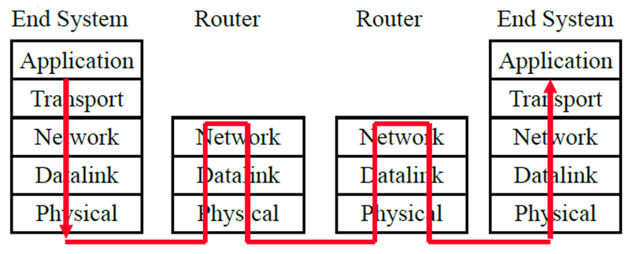
Transport Layer Design Issues
Transport = End-to-End Services: Services required at source and destination systems, Not required on intermediate hops

Slide 6
Transport Layer Functions
1. Multiplexing and demultiplexing: among applications and processes at end systems
Error detection: Bit errors
3. Loss detection: Lost packets due to buffer overflow at intermediate systems (Sequence numbers and acks)
4. Error/loss recovery: Retransmissions
5. Flow control: Ensuring receiver has buffers
6. Congestion Control: Ensuring network has capacity
Not all transports provide all functions

Slide 7
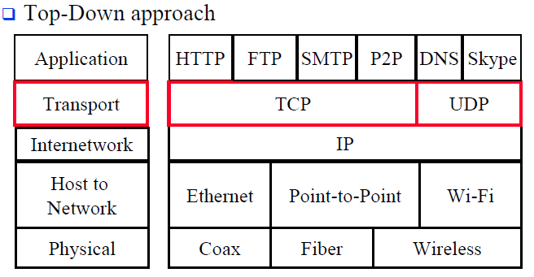
Protocol Layers

Slide 8
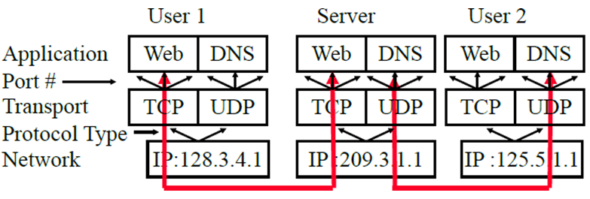
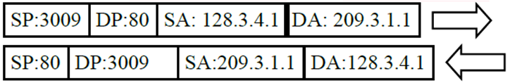
Transport Layer Functions
Transport Ports and Network addresses are used to separate flows

Slide 9
Chapter 3 outline
3.1 transport-layer services
3.2 multiplexing and demultiplexing
3.3 connectionless transport: UDP
3.4 principles of reliable data transfer
3.5 connection-oriented transport: TCP
segment structure
reliable data transfer
flow control
connection management
3.6 principles of congestion control
3.7 TCP congestion control

Slide 10

Multiplexing/demultiplexing
Extending host-to-host delivery to process-to-process delivery is called transport-layer multiplexing and demultiplexing.
multiplexing at sender:
demultiplexing at receiver:
handle data from multiple
sockets, add transport header (later used for demultiplexing)
use header info to deliver
received segments to correct
socket
application
application
P1
P2
application
socket
P3
transport
P4
process
transport
network
transport
network
link
network
link
physical
link
physical
physical

Slide 11
Defining multiplexing
The job of gathering data chunks at the source host from different sockets, encapsulating each data chunk with header information (that will later be used in demultiplexing) to create segments, and passing the segments to the network layer is called multiplexing.

Slide 12
How demultiplexing works
host receives IP datagrams
each datagram has source IP address, destination IP address
each datagram carries one transport-layer segment
each segment has source, destination port number
host uses IP addresses & port numbers to direct segment to appropriate socket
32 bits
source port #
dest port #
other header fields
application
data
(payload)
TCP/UDP segment format

Slide 13
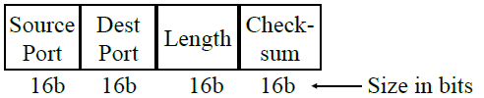
User Datagram Protocol (UDP)
Connectionless end-to-end service
Provides multiplexing via ports
Error detection (Checksum) optional. Applies to pseudo-header (same as TCP) and UDP segment. If not used, it is set to zero.
No error recovery (no acks). No retransmissions.
Used by network management, DNS, Streamed multimedia (Applications that are loss tolerant, delay sensitive, or have their own reliability mechanisms)

Slide 14
A UDP socket is fully identified by a two-tuple consisting of a destination IP address and a destination port number. As a consequence
Connectionless demultiplexing
DatagramSocket serverSocket = new DatagramSocket
(6428);
DatagramSocket mySocket2 = new DatagramSocket
(9157);
DatagramSocket mySocket1 = new DatagramSocket (5775);
application
application
P1
application
P3
P4
transport
transport
network
transport
network
link
network
link
physical
link
physical
physical
source port: 6428
dest port: 9157
source port: ?
dest port: ?
source port: 9157
dest port: 6428
source port: ?
dest port: ?

Slide 15
Connection-oriented demux
TCP socket identified by 4-tuple:
source IP address
source port number
dest IP address
dest port number
demux: receiver uses all four values to direct segment to appropriate socket
server host may support many simultaneous TCP sockets:
each socket identified by its own 4-tuple
web servers have different sockets for each connecting client
non-persistent HTTP will have different socket for each request

Slide 16
Connection-oriented demux: example
application
application
P4
P5
P6
application
P3
P2
P3
transport
transport
network
transport
network
link
network
link
physical
link
physical
server: IP address B
physical
host: IP address A
source IP,port: B,80
dest IP,port: A,9157
host: IP address C
source IP,port: C,5775
dest IP,port: B,80
source IP,port: A,9157
dest IP, port: B,80
source IP,port: C,9157
dest IP,port: B,80
three segments, all destined to IP address: B,
dest port: 80 are demultiplexed to different sockets

Slide 17
Connection-oriented demux: example
threaded server
application
application
application
P4
P3
P3
P2
transport
transport
network
transport
network
link
network
link
physical
link
physical
server: IP address B
physical
host: IP address A
source IP,port: B,80
dest IP,port: A,9157
host: IP address C
source IP,port: C,5775
dest IP,port: B,80
source IP,port: A,9157
dest IP, port: B,80
source IP,port: C,9157
dest IP,port: B,80

Slide 18
Chapter 3 outline
3.1 transport-layer services
3.2 multiplexing and demultiplexing
3.3 connectionless transport: UDP
3.4 principles of reliable data transfer
3.5 connection-oriented transport: TCP
segment structure
reliable data transfer
flow control
connection management
3.6 principles of congestion control
3.7 TCP congestion control

Slide 19
UDP: User Datagram Protocol [RFC 768]
“no frills,” “bare bones” Internet transport protocol
“best effort” service, UDP segments may be:
lost
delivered out-of-order to app
connectionless:
no handshaking between UDP sender, receiver
each UDP segment handled independently of others
UDP use:
streaming multimedia apps (loss tolerant, rate sensitive)
DNS
SNMP
reliable transfer over UDP:
add reliability at application layer
application-specific error recovery!

Slide 20
UDP: segment header
length, in bytes of UDP segment+header
32 bits
source port #
dest port #
length
checksum
why is there a UDP?
no connection establishment (which can add delay)
simple: no connection state at sender, receiver
small header size
no congestion control: UDP can blast away as fast as desired
application
data
(payload)
UDP segment format

Slide 21
Error Detection: UDP checksum
Goal: detect “errors” (e.g., flipped bits) in transmitted segment
sender:
treat segment contents, including header fields, as sequence of 16-bit integers
checksum: addition (one’s complement sum) of segment contents
sender puts checksum value into UDP checksum field
receiver:
compute checksum of received segment
check if computed checksum equals checksum field value:
NO - error detected
YES - no error detected. But maybe errors nonetheless? More later ….

Slide 22
Error Detection: UDP checksum
Cyclic Redundancy Check (CRC): Powerful but generally requires hardware
Checksum: Weak but easily done in software
Example: 1's complement of 1’s complement sum of 16-bit words with overflow wrapped around

Slide 23
Error Detection: UDP checksum
Subtraction :
Subtraction of a number from another can be accomplished by adding the complement of the subtrahend to the minuend.
1’s complement:
Subtraction of binary numbers using the 1’s complement method allows subtraction only by addition.
The 1’s complement of a binary number can be obtained by changing all 1s to 0s and all 0s and 1s.

Slide 24
1’s and 2’s complement
2’s Complement: -ve of a number is complement +1
1 = 0001 -1 = 1111
2 = 0010 -2 = 1110
0 = 0000 -0 = 0000
1’s complement: -ve of a number is it’s complement
1 = 0001 -1 = 1110
2 = 0010 -2 = 1101
0 = 0000 -0 = 1111

Slide 25
1’s and 2’s complement (cont.)
2’s Complement sum: Add with carry. Drop the final carry, if any.
6-7 = 0110 + (-0111) = 0110 + 1001 = 1111 => -1
1’s complement sum: Add with carry. Add end-around carry back to sum
6-7 = 0110 + (-0111) = 0110+1000 = 1110 => -1
Complement of 1’s complement sum: 0001
Checksum: At the transmitter: 0110 1000, append 0001
At the receiver: 0110 1000 0001 compute checksum of the full packet = complement of sum = complement of 1111 = 0000

Slide 26
Error Detection: Internet checksum: example
example: add two 16-bit integers
1 1 1 1 0 0 1 1 0 0 1 1 0 0 1 1 0
1 1 1 0 1 0 1 0 1 0 1 0 1 0 1 0 1
1 1 0 1 1 1 0 1 1 1 0 1 1 1 0 1 1
1 1 0 1 1 1 0 1 1 1 0 1 1 1 1 0 0
1 0 1 0 0 0 1 0 0 0 1 0 0 0 0 1 1
wraparound
sum
checksum
Note: when adding numbers, a carryout from the most significant bit needs to be added to the result
Notes:
Kurose and Ross forgot to say anything about wrapping the carry and adding it to low order bit

Slide 27
UDP Summary
UDP provides flow multiplexing using port #s
UDP optionally provides error detection using the checksum
UDP does not have error or loss recovery mechanism

Slide 28
Chapter 3 outline
3.1 transport-layer services
3.2 multiplexing and demultiplexing
3.3 connectionless transport: UDP
3.4 principles of reliable data transfer
3.5 connection-oriented transport: TCP
segment structure
reliable data transfer
flow control
connection management
3.6 principles of congestion control
3.7 TCP congestion control

Slide 29
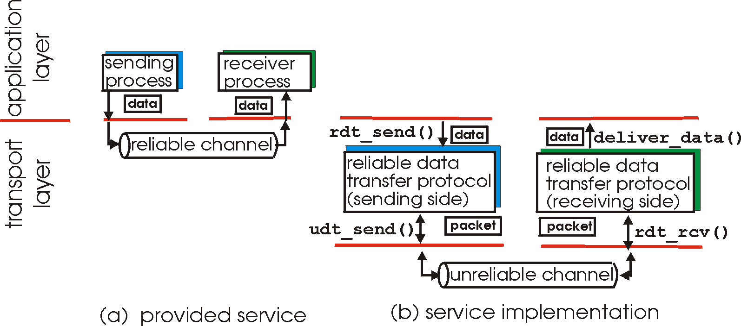
Principles of reliable data transfer
important in application, transport, link layers
top-10 list of important networking topics!
characteristics of unreliable channel will determine complexity of reliable data transfer protocol (rdt)

Slide 30
Principles of reliable data transfer (rdt)
important in application, transport, link layers
top-10 list of important networking topics!
characteristics of unreliable channel will determine complexity of reliable data transfer protocol (rdt)

Slide 31
Principles of reliable data transfer
important in application, transport, link layers
top-10 list of important networking topics!
characteristics of unreliable channel will determine complexity of reliable data transfer protocol (rdt)

Slide 32
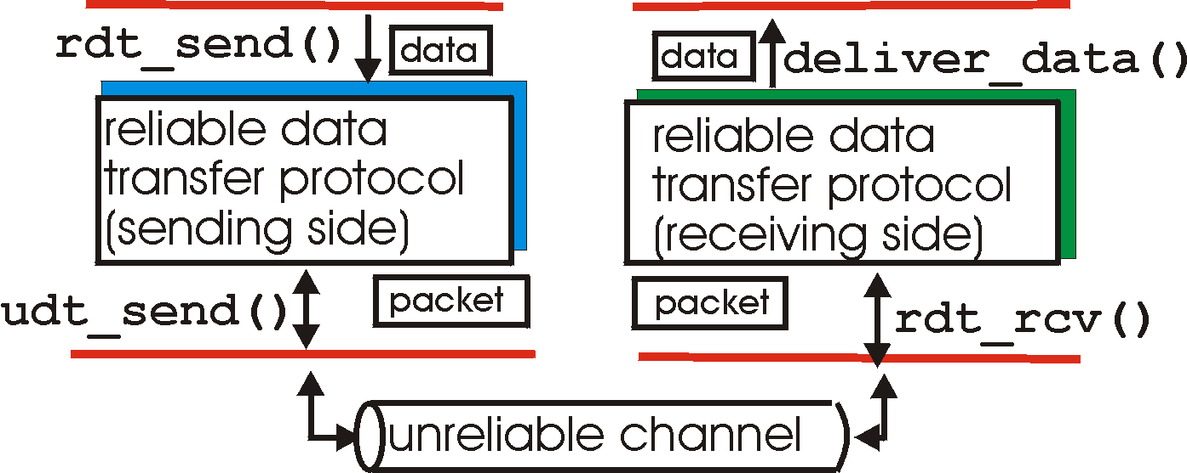
Reliable data transfer: getting started
rdt_send(): called from above, (e.g., by app.). Passed data to
deliver to receiver upper layer
deliver_data(): called by rdt to deliver data to upper
send
side
receive
side
udt_send(): called by rdt,
to transfer packet over
unreliable channel to receiver
rdt_rcv(): called when packet arrives on rcv-side of channel

Slide 33
Reliable data transfer: getting started
we’ll:
incrementally develop sender, receiver sides of reliable data transfer protocol (rdt)
consider only unidirectional data transfer
but control info will flow on both directions!
use finite state machines (FSM) to specify sender, receiver
= no event.action
event causing state transition
actions taken on state transition
state: when in this “state” next state uniquely determined by next event
state
1
state
2
event
actions

Slide 34
rdt1.0: reliable transfer over a reliable channel
underlying channel perfectly reliable
no bit errors
no loss of packets
separate FSMs for sender, receiver:
sender sends data into underlying channel
receiver reads data from underlying channel
Wait for call from above
rdt_send(data)
Wait for call from below
rdt_rcv(packet)
extract (packet,data)
deliver_data(data)
packet = make_pkt(data)
udt_send(packet)
sender
receiver

Slide 35
rdt2.0: channel with bit errors
underlying channel may flip bits in packet
checksum to detect bit errors
the question: how to recover from errors:
acknowledgements (ACKs): receiver explicitly tells sender that pkt received OK
negative acknowledgements (NAKs): receiver explicitly tells sender that pkt had errors
sender retransmits pkt on receipt of NAK
new mechanisms in rdt2.0 (beyond rdt1.0):
error detection
receiver feedback: control msgs (ACK,NAK) rcvr->sender
How do humans recover from “errors”
during conversation?

Slide 36
rdt2.0: channel with bit errors
underlying channel may flip bits in packet
checksum to detect bit errors
the question: how to recover from errors:
acknowledgements (ACKs): receiver explicitly tells sender that pkt received OK
negative acknowledgements (NAKs): receiver explicitly tells sender that pkt had errors
sender retransmits pkt on receipt of NAK
new mechanisms in rdt2.0 (beyond rdt1.0):
error detection
feedback: control msgs (ACK,NAK) from receiver to sender

Slide 37
rdt2.0: FSM specification
rdt_send(data)
sndpkt = make_pkt(data, checksum)
udt_send(sndpkt)
receiver
rdt_rcv(rcvpkt) &&
isNAK(rcvpkt)
Wait for call from above
Wait for ACK or NAK
rdt_rcv(rcvpkt) &&
corrupt(rcvpkt)
udt_send(sndpkt)
udt_send(NAK)
rdt_rcv(rcvpkt) && isACK(rcvpkt)
Λ
Wait for call from below
sender
rdt_rcv(rcvpkt) &&
notcorrupt(rcvpkt)
extract(rcvpkt,data)
deliver_data(data)
udt_send(ACK)

Slide 38
rdt2.0: operation with no errors
rdt_send(data)
snkpkt = make_pkt(data, checksum)
udt_send(sndpkt)
rdt_rcv(rcvpkt) &&
isNAK(rcvpkt)
Wait for call from above
Wait for ACK or NAK
rdt_rcv(rcvpkt) &&
corrupt(rcvpkt)
udt_send(sndpkt)
udt_send(NAK)
rdt_rcv(rcvpkt) && isACK(rcvpkt)
Wait for call from below
Λ
rdt_rcv(rcvpkt) &&
notcorrupt(rcvpkt)
extract(rcvpkt,data)
deliver_data(data)
udt_send(ACK)

Slide 39
rdt2.0: error scenario
rdt_send(data)
sndpkt = make_pkt(data, checksum)
udt_send(sndpkt)
rdt_rcv(rcvpkt) &&
isNAK(rcvpkt)
Wait for call from above
Wait for ACK or NAK
rdt_rcv(rcvpkt) &&
corrupt(rcvpkt)
udt_send(sndpkt)
udt_send(NAK)
rdt_rcv(rcvpkt) && isACK(rcvpkt)
Wait for call from below
Λ
rdt_rcv(rcvpkt) &&
notcorrupt(rcvpkt)
extract(rcvpkt,data)
deliver_data(data)
udt_send(ACK)

Slide 40
rdt2.0 has a fatal flaw!
what happens if ACK/NAK corrupted?
sender doesn’t know what happened at receiver!
can’t just retransmit: possible duplicate
handling duplicates:
sender retransmits current pkt if ACK/NAK corrupted
sender adds sequence number to each pkt
receiver discards (doesn’t deliver up) duplicate pkt
stop and wait
sender sends one packet,
then waits for receiver
response

Slide 41
rdt2.1: sender, handles garbled ACK/NAKs
rdt_send(data)
sndpkt = make_pkt(0, data, checksum)
udt_send(sndpkt)
rdt_rcv(rcvpkt) && (corrupt(rcvpkt) || isNAK(rcvpkt) )
Wait for call 0 from above
Wait for ACK or NAK 0
udt_send(sndpkt)
rdt_rcv(rcvpkt)
&& notcorrupt(rcvpkt)
&& isACK(rcvpkt)
rdt_rcv(rcvpkt) && notcorrupt(rcvpkt) && isACK(rcvpkt)
Wait for ACK or NAK 1
Wait for
call 1 from above
rdt_rcv(rcvpkt) &&
( corrupt(rcvpkt) ||
isNAK(rcvpkt) )
rdt_send(data)
udt_send(sndpkt)
sndpkt = make_pkt(1, data, checksum)
udt_send(sndpkt)

Slide 42
rdt2.1: receiver, handles garbled ACK/NAKs
rdt_rcv(rcvpkt) && notcorrupt(rcvpkt)
&& has_seq0(rcvpkt)
extract(rcvpkt,data)
deliver_data(data)
sndpkt = make_pkt(ACK, chksum)
udt_send(sndpkt)
rdt_rcv(rcvpkt) && (corrupt(rcvpkt)
rdt_rcv(rcvpkt) && (corrupt(rcvpkt)
sndpkt = make_pkt(NAK, chksum)
udt_send(sndpkt)
sndpkt = make_pkt(NAK, chksum)
udt_send(sndpkt)
Wait for
0 from below
Wait for
1 from below
rdt_rcv(rcvpkt) &&
not corrupt(rcvpkt) &&
has_seq1(rcvpkt)
rdt_rcv(rcvpkt) &&
not corrupt(rcvpkt) &&
has_seq0(rcvpkt)
sndpkt = make_pkt(ACK, chksum)
udt_send(sndpkt)
sndpkt = make_pkt(ACK, chksum)
udt_send(sndpkt)
rdt_rcv(rcvpkt) && notcorrupt(rcvpkt)
&& has_seq1(rcvpkt)
extract(rcvpkt,data)
deliver_data(data)
sndpkt = make_pkt(ACK, chksum)
udt_send(sndpkt)

Slide 43
rdt2.1: discussion
sender:
seq # added to pkt
two seq. #’s (0,1) will suffice. Why?
must check if received ACK/NAK corrupted
twice as many states
state must “remember” whether “expected” pkt should have seq # of 0 or 1
receiver:
must check if received packet is duplicate
state indicates whether 0 or 1 is expected pkt seq #
note: receiver can not know if its last ACK/NAK received OK at sender

Slide 44
rdt2.2: a NAK-free protocol
same functionality as rdt2.1, using ACKs only
instead of NAK, receiver sends ACK for last pkt received OK
receiver must explicitly include seq # of pkt being ACKed
duplicate ACK at sender results in same action as NAK: retransmit current pkt

Slide 45
rdt2.2: sender, receiver fragments
rdt_send(data)
sndpkt = make_pkt(0, data, checksum)
udt_send(sndpkt)
rdt_rcv(rcvpkt) &&
( corrupt(rcvpkt) ||
isACK(rcvpkt,1) )
Wait for call 0 from above
Wait for ACK
0
udt_send(sndpkt)
sender FSM
fragment
rdt_rcv(rcvpkt)
&& notcorrupt(rcvpkt)
&& isACK(rcvpkt,0)
rdt_rcv(rcvpkt) &&
(corrupt(rcvpkt) ||
has_seq1(rcvpkt))
Λ
Wait for
0 from below
receiver FSM
fragment
udt_send(sndpkt)
rdt_rcv(rcvpkt) && notcorrupt(rcvpkt)
&& has_seq1(rcvpkt)
extract(rcvpkt,data)
deliver_data(data)
sndpkt = make_pkt(ACK1, chksum)
udt_send(sndpkt)

Slide 46
rdt3.0: channels with errors and loss
new assumption: underlying channel can also lose packets (data, ACKs)
checksum, seq. #, ACKs, retransmissions will be of help … but not enough
approach: sender waits “reasonable” amount of time for ACK
retransmits if no ACK received in this time
if pkt (or ACK) just delayed (not lost):
retransmission will be duplicate, but seq. #’s already handles this
receiver must specify seq # of pkt being ACKed
requires countdown timer

Slide 47
rdt3.0 sender
rdt_send(data)
rdt_rcv(rcvpkt) &&
( corrupt(rcvpkt) ||
isACK(rcvpkt,1) )
sndpkt = make_pkt(0, data, checksum)
udt_send(sndpkt)
start_timer
rdt_rcv(rcvpkt)
Λ
Λ
Wait for
call 0from above
Wait for ACK0
timeout
udt_send(sndpkt)
start_timer
rdt_rcv(rcvpkt)
&& notcorrupt(rcvpkt)
&& isACK(rcvpkt,1)
rdt_rcv(rcvpkt)
&& notcorrupt(rcvpkt)
&& isACK(rcvpkt,0)
stop_timer
stop_timer
Wait for ACK1
Wait for
call 1 from above
timeout
udt_send(sndpkt)
start_timer
rdt_rcv(rcvpkt)
rdt_send(data)
Λ
rdt_rcv(rcvpkt) &&
( corrupt(rcvpkt) ||
isACK(rcvpkt,0) )
sndpkt = make_pkt(1, data, checksum)
udt_send(sndpkt)
start_timer
Λ

Slide 48

rdt3.0 in action
sender
receiver
sender
receiver
send pkt0
pkt0
send pkt0
pkt0
rcv pkt0
rcv pkt0
ack0
send ack0
ack0
send ack0
rcv ack0
rcv ack0
send pkt1
pkt1
send pkt1
pkt1
rcv pkt1
X
ack1
send ack1
loss
rcv ack1
send pkt0
pkt0
rcv pkt0
timeout
resend pkt1
ack0
send ack0
pkt1
rcv pkt1
ack1
send ack1
rcv ack1
send pkt0
pkt0
(a) no loss
rcv pkt0
ack0
send ack0
(b) packet loss

Slide 49
rdt3.0 in action
sender
receiver
sender
receiver
send pkt0
pkt0
send pkt0
pkt0
rcv pkt0
rcv pkt0
ack0
send ack0
send ack0
rcv ack0
ack0
send pkt1
pkt1
rcv ack0
rcv pkt1
send pkt1
pkt1
send ack1
rcv pkt1
ack1
send ack1
ack1
X
loss
timeout
resend pkt1
pkt1
rcv pkt1
timeout
resend pkt1
rcv ack1
pkt1
rcv pkt1
pkt0
(detect duplicate)
send pkt0
send ack1
ack1
(detect duplicate)
ack1
rcv pkt0
rcv ack1
send ack1
rcv ack1
ack0
send ack0
pkt0
send pkt0
pkt0
send pkt0
rcv pkt0
rcv pkt0
ack0
(detect duplicate)
ack0
send ack0
send ack0
(c) ACK loss
(d) premature timeout/ delayed ACK

Slide 50
Performance of rdt3.0
rdt3.0 works, but performance stinks
ex: 1 Gbps link, 15 ms prop. delay, 8000 bit packet and 100bit ACK:
What is the total delay
Data transmission delay
8000/10⁹ = 8×10⁻⁶
ACK Transmission delay
100/10⁹ = 10⁻⁷ sec
Total Delay
2×15ms + .008 + .0001=30.0081ms
Utilization
Time transmitting / total time
.008 / 30.0081 = 0.00027
This is one pkt every 30msec or 33 kB/sec over a 1 Gbps link!

Slide 51
Flow Control

Slide 52
Flow Control: do not want to send more which receiver can not take
Flow Control
Specifies the amount of data can be transmitted by sender before receiving permission to continue from receiver
Error Control
Allows receiver
To find damaged or lost frames during transmission
To coordinate re-transmission of those frames by sender
Flow Control & Error Control
Flow control must acknowledge the correctly-received frames, So it is closely linked to error control

Slide 53
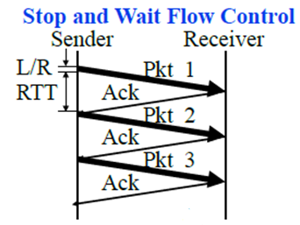
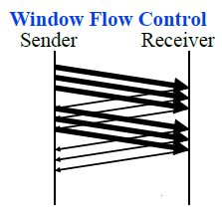



Flow Control
Flow Control Goals:
Sender does not flood the receiver,
Maximize throughput

Slide 54
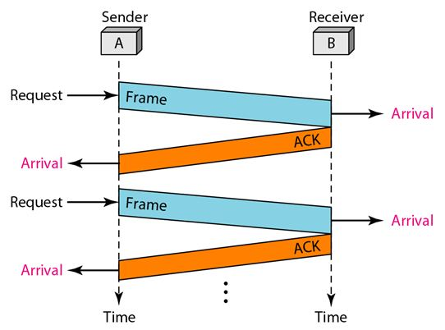

Slide 55
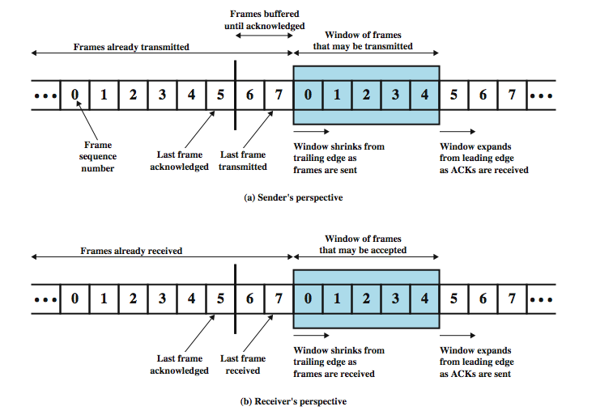
Sliding Window Operation

Slide 56
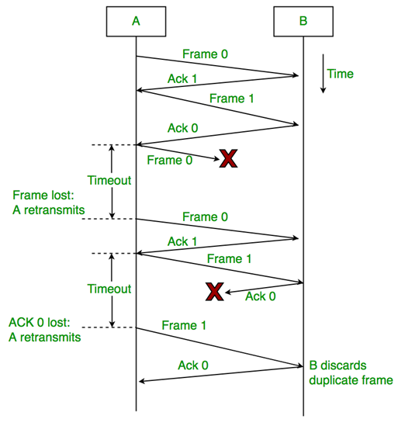
Stop and wait
Use of sequence numbers each frame and the corresponding acknowledgement identify to individually
Maximum size of the sequence number?
Automatic Repeat Request

Slide 57
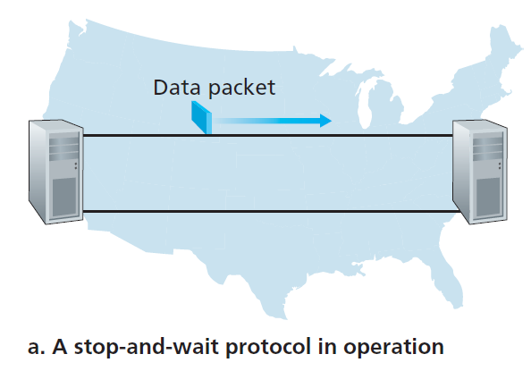
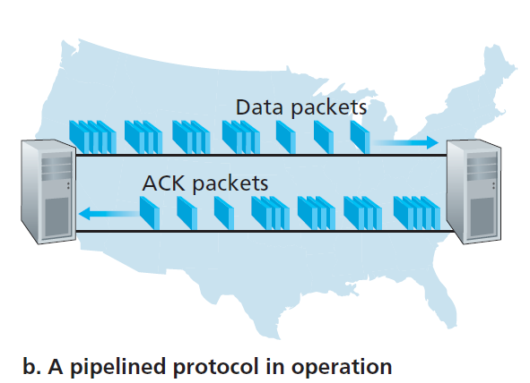

Slide 58

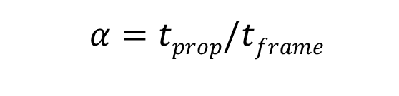
Stop-and-wait Flow Control
sender
receiver
first packet bit transmitted, t = 0
last packet bit transmitted, t = L / R
first packet bit arrives
RTT
last packet bit arrives, send ACK
ACK arrives, send next
packet, t = RTT + L / R
L/R=t_{frame}
RTT=2t_{prop}
$$α=tprop/tframe$$

Slide 59
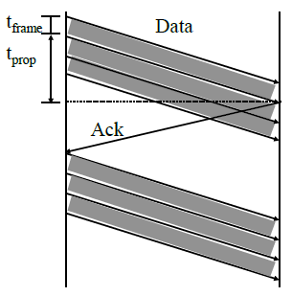

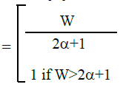


Sliding Window Protocol Efficiency

Slide 60
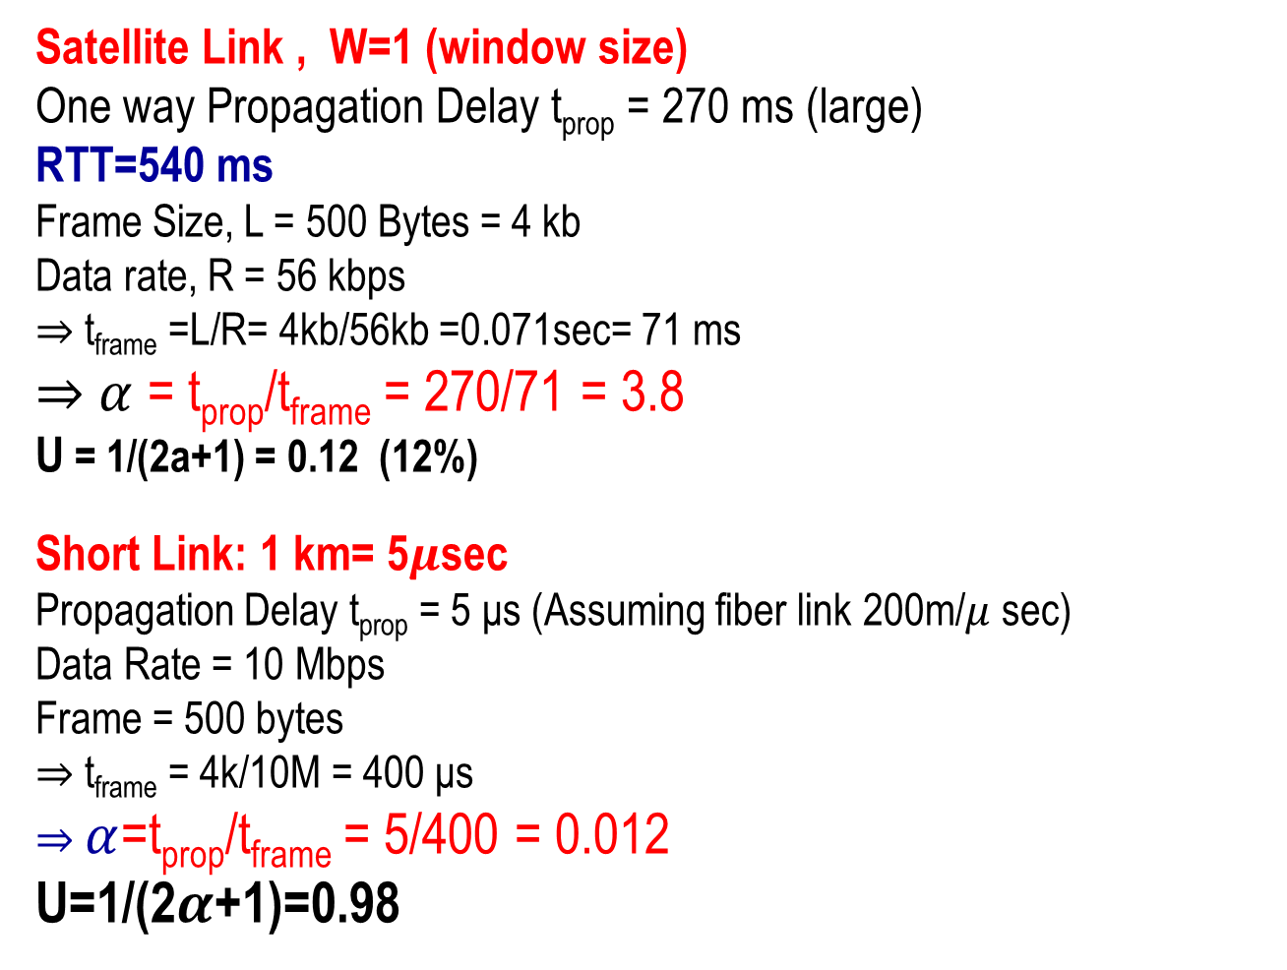
Utilization: Examples
Satellite Link , W=1 (window size)
One way Propagation Delay t_{prop} = 270 ms (large)
RTT=540 ms
Frame Size, L = 500 Bytes = 4 kb
Data rate, R = 56 kbps
⇒ t_{frame} =L/R= 4kb/56kb =0.071sec= 71 ms
⇒ $α$ = t_{prop}/t_{frame} = 270/71 = 3.8
U = 1/(2a+1) = 0.12 (12%)
Short Link: 1 km= 5$μ$sec
Propagation Delay t_{prop} = 5 μs (Assuming fiber link 200m/$μ$ sec)
Data Rate = 10 Mbps
Frame = 500 bytes
⇒ t_{frame} = 4k/10M = 400 μs
⇒ $α$=t_{prop}/t_{frame} = 5/400 = 0.012
U=1/(2$α$+1)=0.98

Slide 61
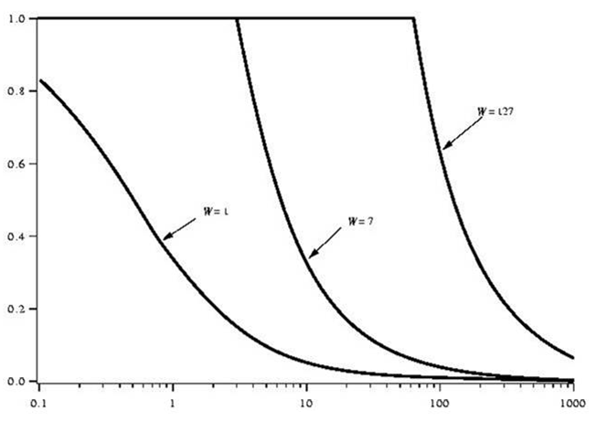
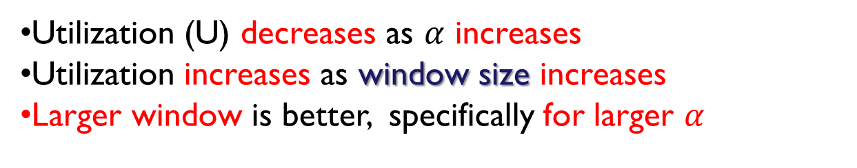

Sliding Window Utilization: Effect of window size
Utilization (U) decreases as $α$ increases
Utilization increases as window size increases
Larger window is better, specifically for larger $α$
U
$$α$$

Slide 62
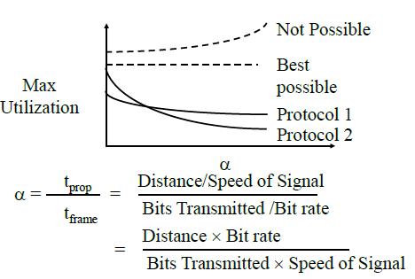
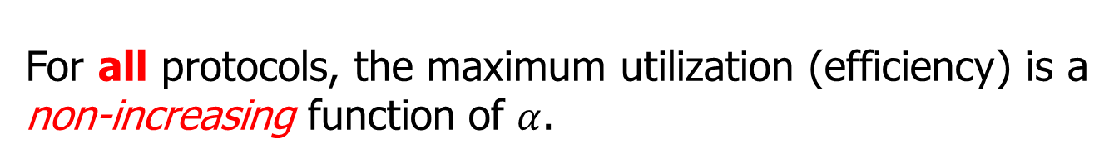
Efficiency Principle
For all protocols, the maximum utilization (efficiency) is a non-increasing function of $α$.

Slide 63
Error Control

Slide 64
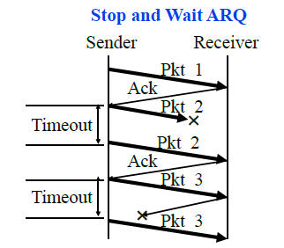
Retransmissions
Error control: When something is lost
Send packet, wait until time out, retransmit
Retransmit lost packets after a timeout ⇒ Automatic Repeat reQuest (ARQ)

Slide 65
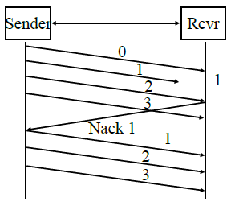
Go-Back-N ARQ
What do we retransmit?
Two methods: GBN and SR
GBN: Receiver does not cache out-of-order frames
Sender has to go back and retransmit all frames after the lost frame
NACK 1 says I did not get 1

Slide 66
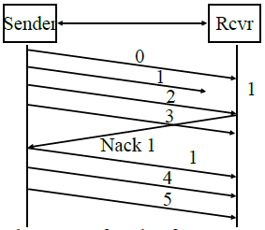
Selective Repeat ARQ
Receiver caches out-of-order frames
Sender retransmits only the lost frame
Also known as selective reject ARQ

Slide 67
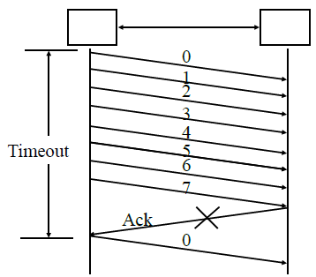
Selective Repeat: Window Size
Window size=7
If the window size is 4, ( sending sequence: 0,1,2,3, 0,1,2,3)
then problem, can not send 0 again as 0 is already outstanding
Sequence number space >= 2 Window size
Window size<2^{n-1}

Slide 68
Transport Layer Design Issues
Multiplexing/demultiplexing by a combination of source and destination IP addresses and port numbers.
Window flow control is better for long-distance or high-speed networks
Longer distance or higher speed ⇒ Larger α ⇒ Larger window is better
Stop and and wait flow control is ok for short distance or low-speed networks
Selective repeat is better than stop and wait ARQ only slightly better than go-back-N

Slide 69
TCP

Slide 70
TCP
Topics
TCP Header Format, Options, Checksum
TCP Connection Management
Round Trip Time Estimation
Principles of Congestion Control
Slow Start Congestion Control

Slide 71

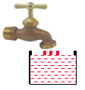
Key Features of TCP
Point-to-Point: One sender, one receiver
Byte Stream: No message boundaries. TCP makes “segments”
Maximum segment size (MSS)
Connection Oriented: Handshake to initialize states before data exchange
Full Duplex: Bidirectional data flow in one connection
Reliable: In-order byte delivery
Flow control: To avoid receiver buffer overflow
Congestion control: To avoid network router buffer
overflow

Slide 72
Transmission Control Protocol
Key Services:
Send: Please send when convenient
Data stream push: Destination TCP, please deliver it immediately to the receiving application. ⇒ Source TCP, please send it now. Set on last packet of an application message.
Urgent data signaling: Destination TCP, please give this urgent data to the user out-of-band. Generally used for CTRL-C.

Slide 73
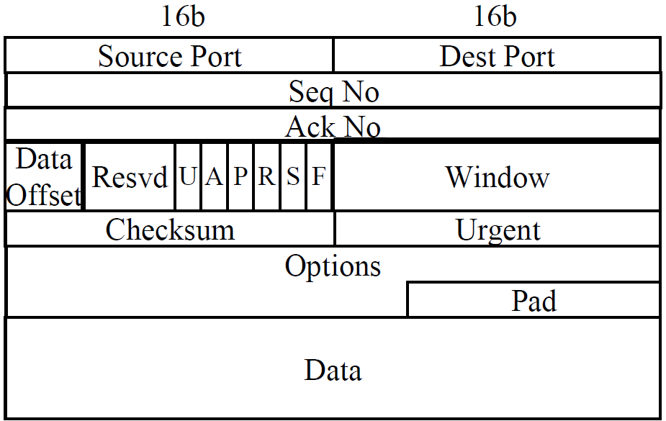
TCP Segment Format (Cont)

Slide 74
TCP Header Fields
Source Port (16 bits): Identifies source user process
Destination Port (16 bits) 21 = FTP, 23 = Telnet, 53 = DNS, 80 = HTTP, ...
Sequence Number (32 bits): Sequence number of the
first byte in the segment. If SYN is present (SYN=1), this is the initial sequence number (ISN) (first packet) and the first data
Byte (not packet) is ISN+1.
Ack number (32 bits): Next byte expected (TCP designer decision what is expected next)
Data offset (4 bits): Number of 32-bit words (unit 32 bits) in the header (starting of data from beginning)
Reserved (6 bits)

Slide 75

TCP Header (Cont)
Control (6 bits):
URG: Urgent pointer field significant,
ACK: Ack field significant,
PUSH: Push function,
RST: Reset the connection,
SYN: Synchronize the sequence numbers,(lets synchronize first sequence number, this is mine, what is yours)
FIN: No more data from sender (I am done, you can send yours and finally also other side send FIN)
Window (16 bits): in byte numbers
Will accept [Ack] to [Ack]+[window]-1

Slide 76
TCP Header (Cont)
Checksum (16 bits): covers the segment plus a pseudo header. Includes the following fields from IP header: source and dest adr, protocol, segment length. Protects from IP misdelivery.
Urgent pointer (16 bits): Points to the byte following urgent data (urgent data ends). Lets receiver know how much data it should deliver right away out-of-band.
Options (variable):
Max segment (TCP packet) size (does not include TCP header, default 536 bytes), Window scale factor (16 bit window, initially 2^16 was large, but not now) (the power of 2, e.g if 3, then unit is 8 bytes as 1 unit) Selective Ack permitted, Timestamp, No-Op, End-of-options

Slide 77
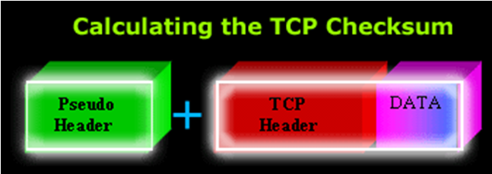
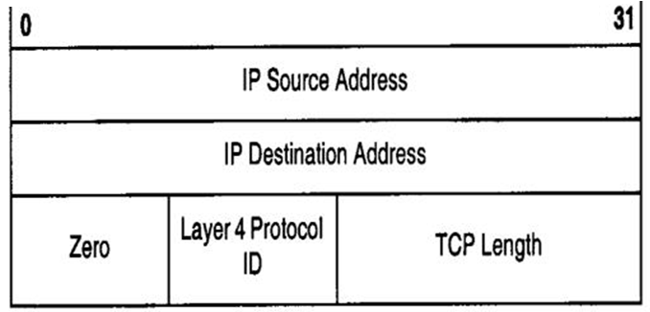
TCP Checksum Calculation

Slide 78
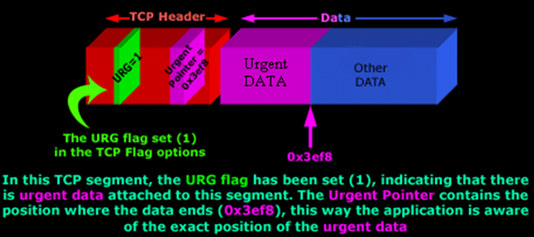
TCP Header (Cont)

Slide 79
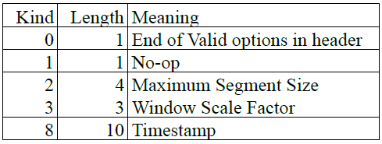
TCP Options
1b
1b
T-(L)-V format (length is fixed)
End of Options: Stop looking for further option
No-op: Ignore this byte. Used to align the next option on a 4-byte word boundary
Max Segment Size (MSS): Does not include TCP header (Max byte that my application will send you)

Slide 80


TCP Checksum
Checksum is the 16-bit one's complement of the one's complement sum of a pseudo header of information from the IP header, the TCP header, and the data, padded with zero octets at the end (if necessary) to make a multiple of two octets.
Checksum field is filled with zeros initially
TCP length (in octet) is not transmitted but used in calculations.
Efficient implementation in RFC1071.
TCP Header and data

Slide 81
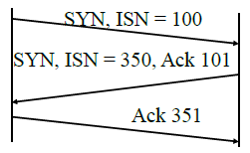
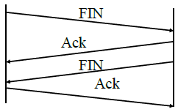
TCP Connection Management
Connection Establishment
Three way handshake
SYN flag set ⇒ Request for connection
Connection Termination
Close with FIN flag set
Abort
ISN=Initial Sequence Number

Slide 82
TCP Sequence #s and ACKs
Seq. #’s:
Byte stream “number” of first byte in segment’s data
ACKs:
Seq. # of next byte expected from other side
Cumulative ACK
Q: How does receiver handle out-of-order segments?
A: TCP spec doesn’t say, up to implementer
Host A
Host B
User
types
‘C’
Seq=42, ACK=79, data = ‘C’
Host ACKs
receipt of
‘C’, echoes
back ‘C’
Seq=79, ACK=43, data = ‘C’
Host ACKs
receipt
of echoed
‘C’
Seq=43, ACK=80
Simple Telnet Scenario
time

Slide 83
TCP: Retransmission Scenarios
Host A
Host B
Host A
Host B
Seq=92, 8 bytes data
Seq=92, 8 bytes data
Seq=100, 20 bytes data
timeout
ACK=100
Seq=92 timeout
X
ACK=100
Seq=100 timeout
ACK=120
loss
Seq=92, 8 bytes data
Seq=92, 8 bytes data
ACK=120
ACK=100
time
time
Premature timeout,
cumulative ACKs
Lost ACK scenario

Slide 84
RTT
buffers
The network must have buffers (to enable statistical multiplexing)
The buffer occupancy is time-varying
As flows start and stop, congestion grows and decreases, causing buffer occupancy to increase and decrease.
RTT is time-varying. There is no single RTT.
Measured round trip time (SampleRTT) is very random.
Solution: make RTO a function of a smoothed RTT

Slide 85
Smooth RTT
EstimatedRTT = (1- α)*EstimatedRTT + α*SampleRTT
Exponential weighted moving average
influence of past sample decreases exponentially fast
typical value: α = 0.125

Slide 86
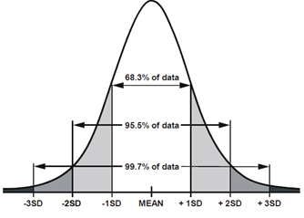
TCP Round Trip Time and Timeout
Setting the timeout (RTO)
EstimatedRTT=(1- α)EstimatedRTT+ α SampleRTT
DevRTT = (1- β) DevRTT+ β |SampleRTT-EstmatedRTT|
TimeoutInterval=EstimatedRTT
+4 DevRTT

Slide 87
Principles of Congestion Control
Congestion:
Informally: “too many sources sending too much data too fast for network to handle”
Different from flow control!
Manifestations:
Lost packets (buffer overflow at routers)
Long delays (queueing in router buffers)
Top-10 problem!

Slide 88
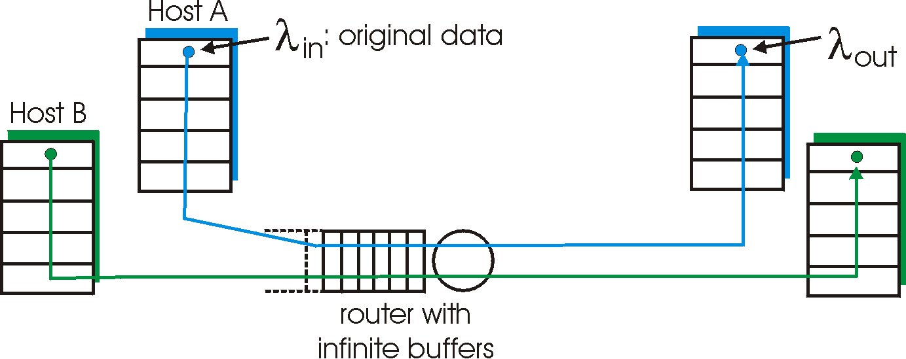
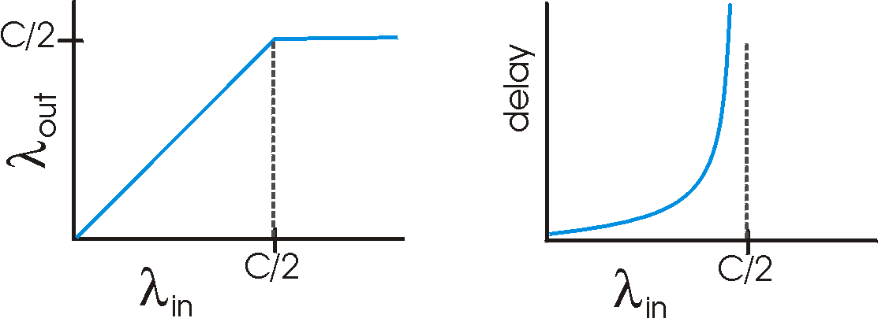
Causes/Costs of Congestion: Scenario 1
Two senders, two receivers
One router, infinite buffers
No retransmission
Large delays when congested
Maximum achievable throughput

Slide 89
Approaches Towards Congestion Control
Two broad approaches towards congestion control:
End-end congestion control:
No explicit feedback from network
Congestion inferred from end-system observed loss, delay
Approach taken by TCP
Network-assisted congestion control:
Routers provide feedback to end systems
Single bit indicating congestion (SNA, DECbit, TCP/IP ECN, ATM)
Explicit rate sender should send at

Slide 90
TCP Congestion Control (2)
“Probing” for usable bandwidth:
Ideally: transmit as fast as possible (cwnd as large as possible) without loss
Increase cwnd until loss (congestion)
Loss: decrease cwnd, then begin probing (increasing) again
Two “phases”
Slow start
Congestion avoidance
Important variables:
cwnd
ssthresh: defines threshold between two slow start phase, congestion control phase

Slide 91
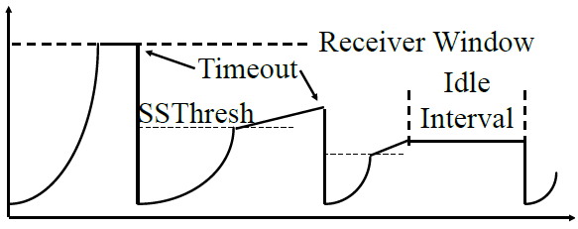
Slow Start Congestion Control
If segments lost, remember slow start threshold (SSThresh) to CWND/2
Set CWND to 1 MSS
Increment by 1MSS per ack until SSThresh
Increment by 1 MSS*MSS/CWND per ack afterwards
bytes
Congestion Window CWND
1MSS
Notes:
\begin{algorithm}
\caption{TCP Slow Start}
\begin{algorithmic}[1]
\STATE{Initialization: $cwnd \leftarrow 1$}
\REPEAT
\FOR{each segment ACKed}
\STATE{$cwnd \leftarrow cwnd + 1$}
\ENDFOR
\UNTIL{loss event or $cwnd > threshold$}
\end{algorithmic}
\end{algorithm}

Slide 92
Slow Start Congestion Control
At the beginning, SSThresh = Receiver window
After a long idle period (exceeding one round-trip time), reset the congestion window to one.
If CWND is W MSS, W acks are received in one round trip.
Below SSThresh, CWND is increased by 1MSS on every ack ⇒ CWND increases to 2W MSS in one round trip ⇒ CWND increases exponentially with time Exponential growth phase is also known as “Slow start” phase
Above SSThresh, CWND is increased by MSS/CWND on every ack ⇒ CWND increases by 1 MSS in one round trip ⇒ CWND increases linearly with time The linear growth phase is known as “congestion avoidance” phase
Notes:
\begin{algorithm}
\caption{TCP Slow Start}
\begin{algorithmic}[1]
\STATE{Initialization: $cwnd \leftarrow 1$}
\REPEAT
\FOR{each segment ACKed}
\STATE{$cwnd \leftarrow cwnd + 1$}
\ENDFOR
\UNTIL{loss event or $cwnd > threshold$}
\end{algorithmic}
\end{algorithm}

Slide 93
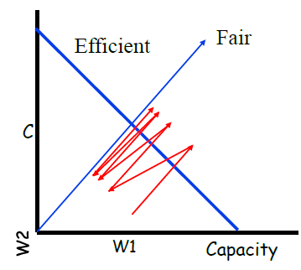
TCP Congestion Avoidance
Additive Increase, Multiplicative Decrease
W1+W2 = Capacity ⇒ Efficiency, W1=W2 ⇒ Fairness
(W1,W2) to (W1+ΔW,W2+ΔW) ⇒ Linear increase (45° line)
(W1,W2) to (kW1,kW2) ⇒ Multiplicative decrease (line through origin)
Notes:
\begin{algorithm}
\caption{TCP Congestion Avoidance}
\begin{algorithmic}[1]
\STATE{// Slow start is over; $cwnd > threshold$}
\REPEAT
\FOR{every $w$ segments ACKed}
\STATE{$cwnd \leftarrow cwnd + 1$}
\ENDFOR
\UNTIL{loss event}
\STATE{$threshold \leftarrow cwnd/2$}
\STATE{$cwnd \leftarrow 1$}
\STATE{Perform slow start$^{*}$}
\end{algorithmic}
\end{algorithm}

Slide 94
TCP Fairness
AIMD
TCP congestion avoidance:
AIMD: Additive increase, multiplicative decrease
Increase window by 1 per RTT
Decrease window by factor of 2 on loss event
Fairness goal: if N TCP sessions share same bottleneck link, each should get 1/N of link capacity
TCP connection 1
TCP
connection 2
Bottleneck
router
capacity C

Slide 95
Why is TCP Fair?
Two competing sessions:
Additive increase gives slope of 1, as throughout increases
Multiplicative decrease decreases throughput proportionally
R
Equal bandwidth share
Connection 2 throughput
Loss: decrease window by factor of 2
Congestion avoidance: additive increase
Loss: decrease window by factor of 2
Congestion avoidance: additive increase
R
Connection 1 throughput

Slide 96
Fast Retransmit (slow start modifications)
Two competing sessions:
Optional – implemented in TCP Reno
(Earlier version was TCP Tahoe)
Duplicate Ack indicates a lost/out-of-order segment
On receiving 3 duplicate acks (4th ack for the same segment):
Enter Fast Recovery mode
Retransmit missing segment
Set SSThresh=CWND/2
Set CWND=SSThresh+3 MSS
Every subsequent duplicate ack: CWND=CWND+1MSS
When a new ack (not a duplicate ack) is received
Exit fast recovery
Set CWND=SSTHRESH

Slide 97
Summary
Principles behind transport layer services:
Multiplexing/demultiplexing
Reliable data transfer
Flow control
Congestion control
Instantiation and implementation in the Internet
UDP
TCP
Next:
Leaving the network “edge” (application transport layer)
Entering the network “core”

Slide 98
Slow Start Congestion Control
Window = Flow control avoids receiver overrun
Need congestion control to avoid network overrun
The sender maintains two windows:
Credits from the receiver (what the receiver said)
Congestion window from the network (what network says)
Congestion window is always less than the receiver window
Starts with a congestion window (CWND) of 1 max segment
size (MSS)
Do not disturb existing connections too much.
Increase CWND by 1 MSS every time an ACK is received
Assume CWND is in bytes

Slide 99
Extra Slides

Slide 100
TCP ACK Generation [RFC 1122, RFC 2581]
Event
In-order segment arrival,
no gaps,
everything else already ACKed
In-order segment arrival,
no gaps,
one delayed ACK pending
Out-of-order segment arrival
higher-than-expect seq. #
gap detected
Arrival of segment that
partially or completely fills gap
TCP Receiver Action
Delayed ACK. Wait up to 500ms
for next segment. If no next segment,
send ACK
Immediately send single
cumulative ACK
Send duplicate ACK, indicating seq. #
of next expected byte
Immediate ACK if segment starts
at lower end of gap

Slide 101
TCP socket and UDP Socet
In order to transmit some data with TCP, you simply drop a datagram in the socket and it will flow through a previously created connection. In turn, UDP is connectionless. The existence or absence of a connection requires that the identifier format of each socket be different: whereas a TCP socket is identified by the quadruple {source IP address, source port number, destination IP address, destination port number}, an UDP socket is identified by the tuple {destination IP address, destination port number}.

Slide 102
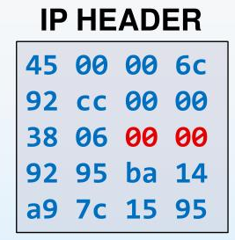
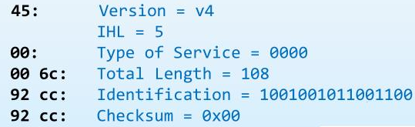
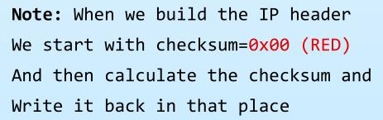

Slide 103
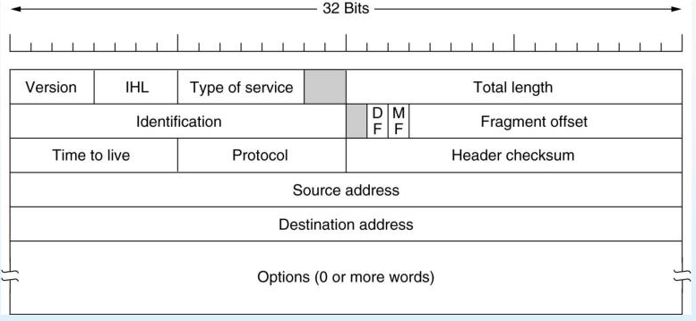

Slide 104
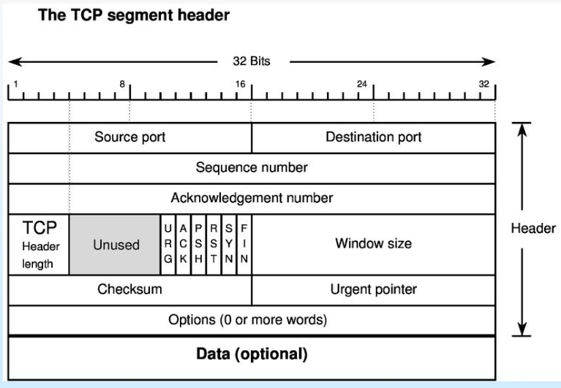

Slide 106
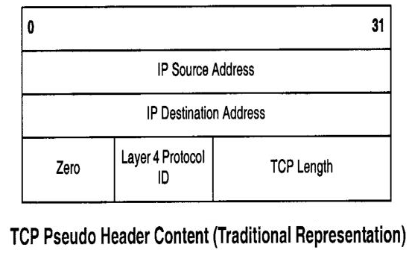

Slide 107
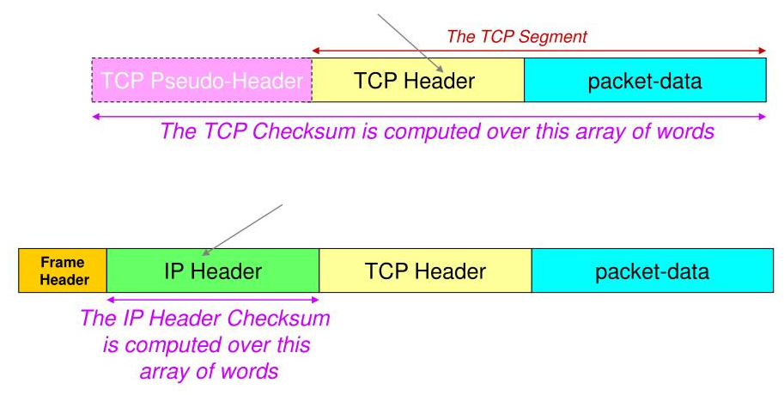
The TCP Checksum gets inserted here
The IP Header Checksum gets inserted here

